Slide 1
CAR Administrator Calibration Meeting - CAR Review -
February 26 2013
Team A: Paul Ip, Thomas Kestner, Balina Ling, Kila Yang

Slide 2
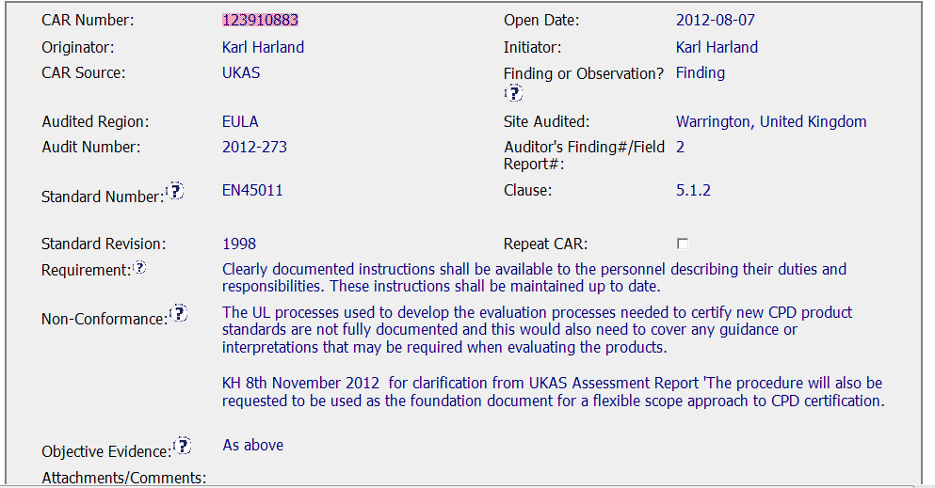
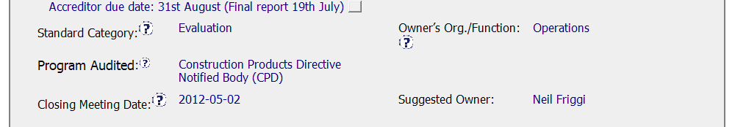
CAR Origination
The non-conformance statement and objective evidence are very clear. Accreditor due date is specified.

Slide 3
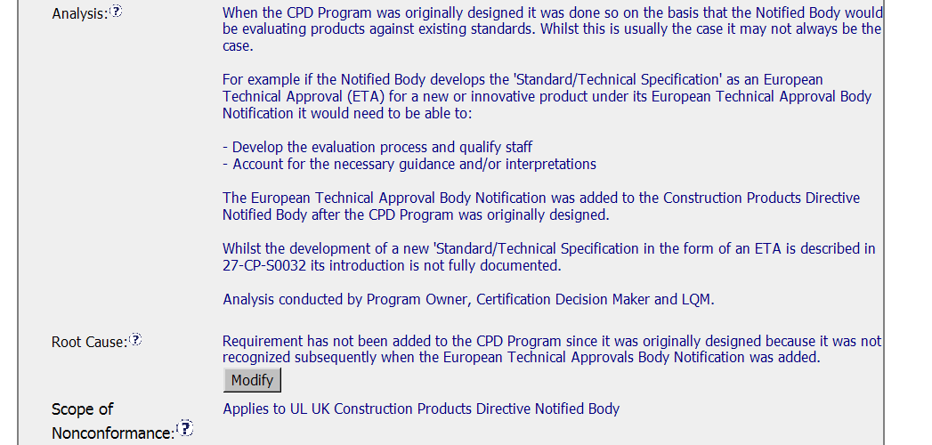
Root Cause Analysis & Scope,
The analysis does not include consideration of already certified products.

Slide 4
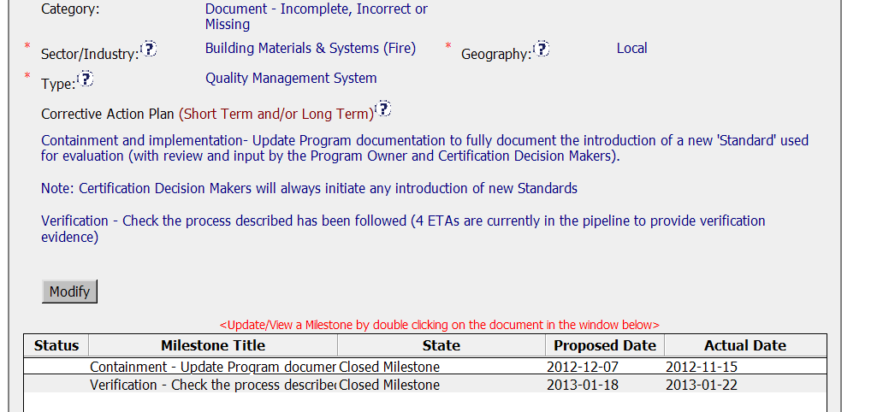
Corrective Action Plan
Corrective action plan specifies a containment plan, but does not address past projects.

Slide 5
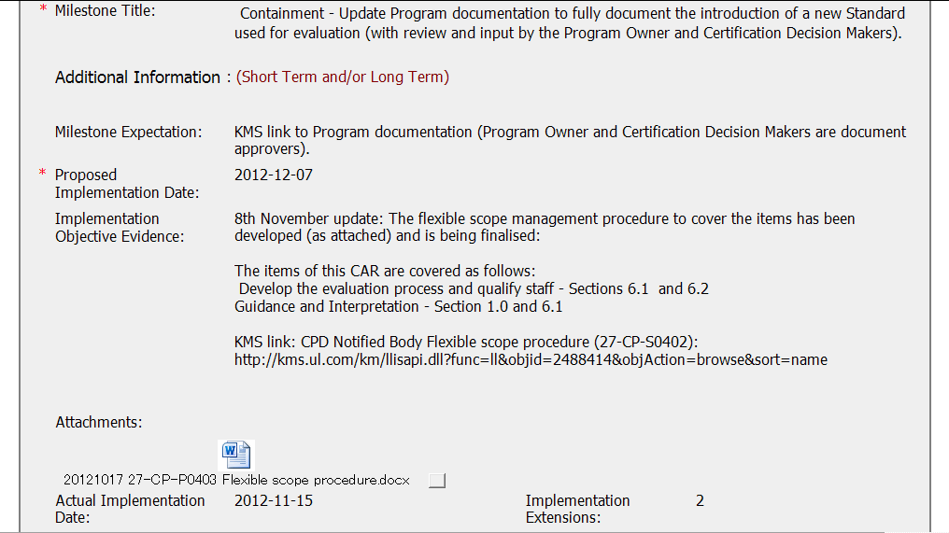
Milestone – Implementation Evidence
Procedure was created and published in KMS, but containment not addressed, although milestone title is “containment”.

Slide 6
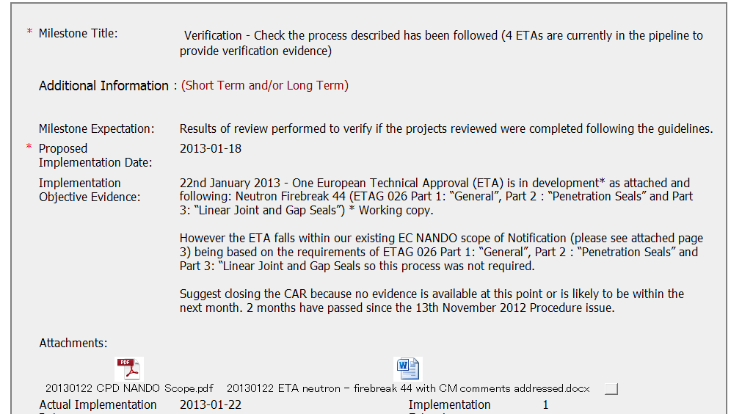
Verification
Verification was attempted, but there was no actual project.

Slide 7

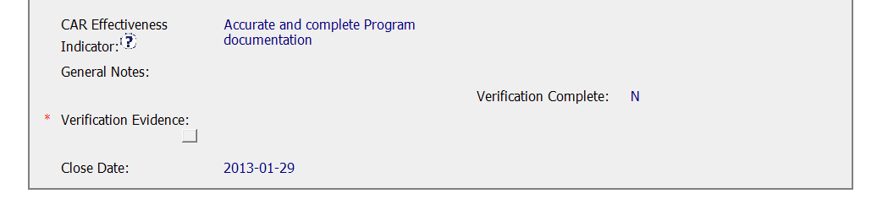
CAR State
CAR Admin needs to verify effectiveness.

Slide 8
CAR Review, 1Q, 2013
B Scala, J Carlisle, K Huang

Slide 9
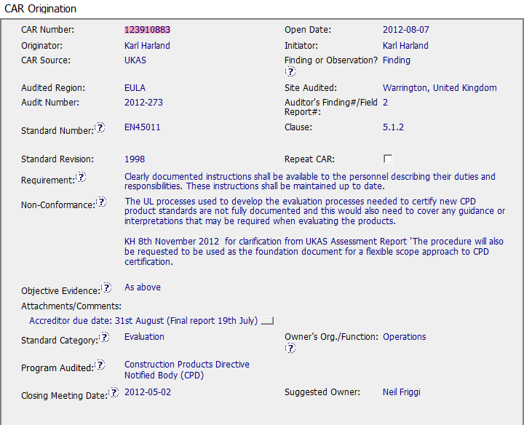
The NC does not support the requirement, & goes into personal preference by the auditor regarding what should be done. Processes cited in the NC do not say which processes are documented & no indication of what document needs to be addressed regarding the CA.
The OE is unclear??

Slide 10
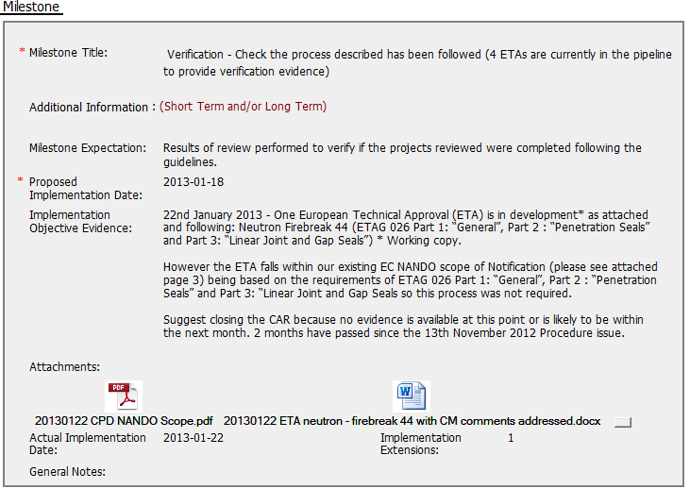
The verification milestone does not include evidence that CA taken was effective. The CAR was recommended for closure too soon.

